Slide 1
Infix to Prefix Conversion using Stack

Slide 2
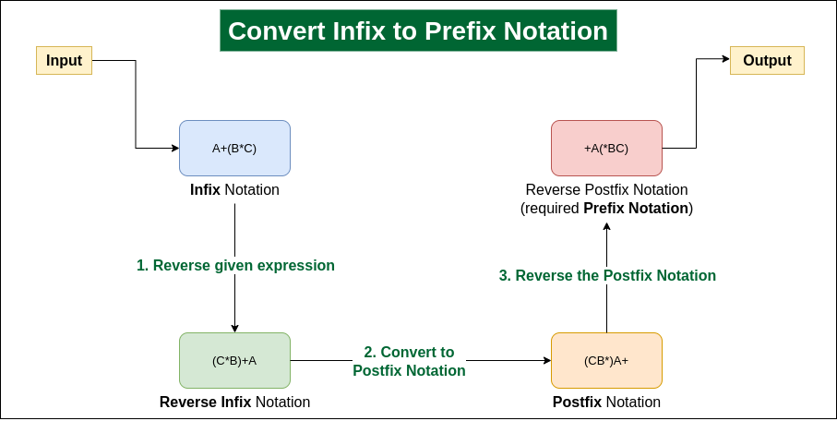

Slide 3
Infix to Prefix Conversion using Stack
Step 1: Reverse the infix expression. Note while reversing each ‘(‘ will become ‘)’ and each ‘)’ becomes ‘(‘.
Step 2: Convert the reversed infix expression to “nearly” postfix expression.
While converting to postfix expression, instead of using pop operation to pop operators with greater than or equal precedence, here we will only pop the operators from stack that have greater precedence.
Step 3: Reverse the postfix expression.

Slide 4
Infix to Prefix Conversion using stack
Eg- P*Q^R+S

Slide 5
Infix to Prefix Conversion using stack
Eg- P*Q^R+S
Reversing Infix=S+R^Q*P
Postfix Expression=SRQ^P*+
Reverse of Postfix=Prefix Notation=+*P^QRS
Scan | Stack | Expression Q
S |  | S
+ | + | S
R | + | SR
^ | +^ | SR
Q | +^ | SRQ
* | +* | SRQ^
P | +* | SRQ^P
End of Expression | Pop all elements | SRQ^P*+

Slide 6
Manual Conversion -Infix to Prefix
Convert the following expressions from Infix to Prefix;
(P*Q^R+S)=+*P^QRS
(A-B/C)*(D*E-F)=*-A/BC-*DEF
(A*B+(C/D))-F=-+*AB/CDF
A+B*C-(D/E^F)*G*H
=A+*BC-(/D^EF)*G*H
=A+*BC-*/D^EFG*H
=A+*BC-**/D^EFGH
=+A*BC-**/D^EFGH
=-+A*BC**/D ^EFGH
(A+B)*C/D+E^F/G
=+AB*C/D+E^F/G
=+AB*C/D+^EF/G
=*+ABC/D+^EF/G
=/*+ABCD+^EF/G
=/*+ABCD+/^EFG
=+/*+ABCD/^EFG

Slide 7
Infix to Prefix Conversion using stack
Eg- (A-B/C)*(D*E-F)

Slide 8
Infix to Prefix Conversion using stack
Eg- (A-B/C)*(D*E-F)
Reversing Infix=(F-E*D)*(C/B-A)
Postfix Expression=FED*-CB/A-*
Reverse of Postfix=Prefix Notation=*-A/BC-*DEF
Scan | Stack | Expression Q
( | (
F | ( | F
- | (- | F
E | (- | FE
* | (-* | FE
D | (-* | FED
) | NULL | FED*-
* | * | FED*-
( | *( | FED*-
C | *( | FED*-C
Scan | Stack | Expression Q
/ | *(/ | FED*-C
B | *(/ | FED*-CB
- | *(- | FED*-CB/
A | *(- | FED*-CB/A
) | * | FED*-CB/A-
End of Expression | Pop all elements | FED*-CB/A-*

Slide 9
Manual Conversion -Infix to Prefix
Convert the following expressions from Infix to Prefix;
(P*Q^R+S)=+*P^QRS
(A-B/C)*(D*E-F)=*-A/BC-*DEF
(A*B+(C/D))-F=-+*AB/CDF
A+B*C-(D/E^F)*G*H
=A+*BC-(/D^EF)*G*H
=A+*BC-*/D^EFG*H
=A+*BC-**/D^EFGH
=+A*BC-**/D^EFGH
=-+A*BC**/D ^EFGH
(A+B)*C/D+E^F/G
=+AB*C/D+E^F/G
=+AB*C/D+^EF/G
=*+ABC/D+^EF/G
=/*+ABCD+^EF/G
=/*+ABCD+/^EFG
=+/*+ABCD/^EFG

Slide 10
Infix to Prefix Conversion using stack
Eg- (A*B+(C/D))-F

Slide 11
Infix to Prefix Conversion using stack
Eg- (A*B+(C/D))-F
Reversing Infix=F-((D/C)+B*A)
Postfix Expression= FDC/BA*+-
Reverse of Postfix=Prefix Notation=-+*AB/CDF
Scan | Stack | Expression Q
F |  | F
- | - | F
( | -( | F
( | -(( | F
D | -(( | FD
/ | -((/ | FD
C | -((/ | FDC
) | -( | FDC/
+ | -(+ | FDC/
B | -(+ | FDC/B
Scan | Stack | Expression Q
* | -(+* | FDC/B
A | -(+* | FDC/BA
) | - | FDC/BA*+
End of Expression | Pop all elements | FDC/BA*+-

Slide 12
Manual Conversion -Infix to Prefix
Convert the following expressions from Infix to Prefix;
(P*Q^R+S)=+*P^QRS
(A-B/C)*(D*E-F)=*-A/BC-*DEF
(A*B+(C/D))-F=-+*AB/CDF
A+B*C-(D/E^F)*G*H
=A+*BC-(/D^EF)*G*H
=A+*BC-*/D^EFG*H
=A+*BC-**/D^EFGH
=+A*BC-**/D^EFGH
=-+A*BC**/D ^EFGH
(A+B)*C/D+E^F/G
=+AB*C/D+E^F/G
=+AB*C/D+^EF/G
=*+ABC/D+^EF/G
=/*+ABCD+^EF/G
=/*+ABCD+/^EFG
=+/*+ABCD/^EFG

